Slide 1
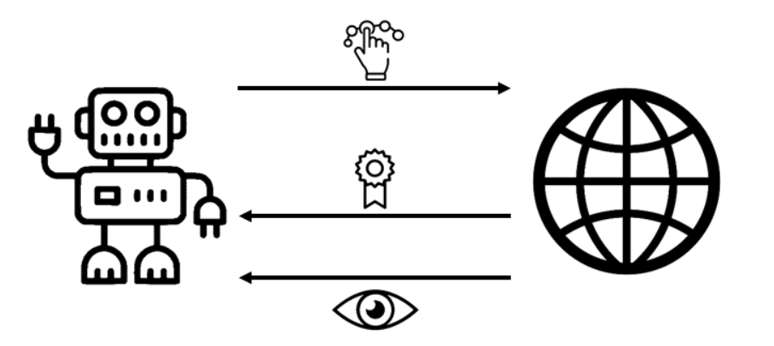
Snake Game using Reinforcement Learning
By
Sri Varshitha Mallampati
Divya Teja Gutha

Slide 2
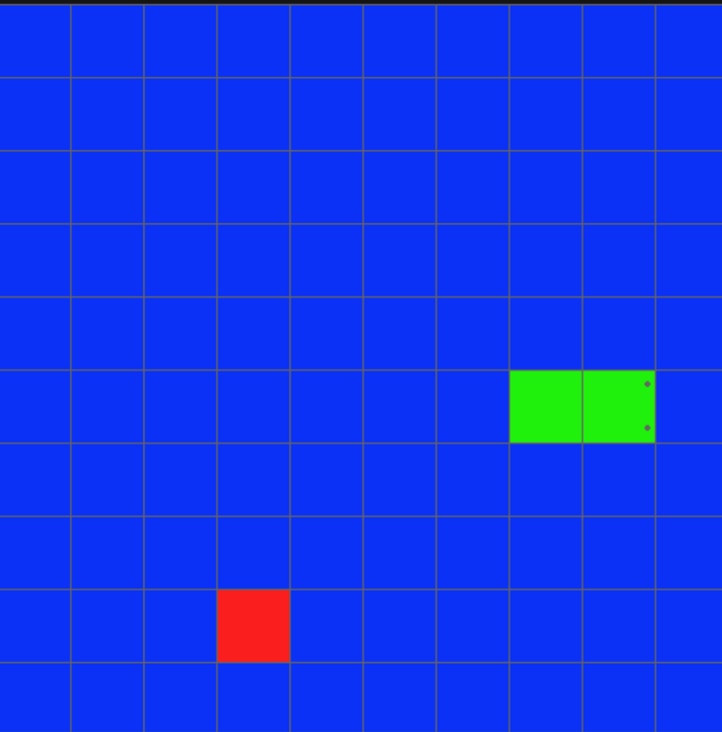
Introduction
Snake is a popular computer game in which players control a snake within a grid on the screen and try to maximize their score. The score increases whenever the snake eats a fruit, which appear on the screen one at a time in a random position. Every time the snake eats a fruit, it grows in its size. The player loses when one of two conditions occurs:
The snake crashes into a wall.
The head of the snake crashed into its own body.

Slide 3
Game Logic
Python
The OpenAi Gym is a framework that was used for defining the RL environment. The following was defined:
Intialization
Steps
When the game is over
Game reset
Left, Right, Up, Down
When the snake hits the fruit, it is given positive reward
When the snake hits the wall, it is given a negative reward

Slide 4
So, how do we teach an agent to play SS?
Well, one way to do it would be to try to come up with a set of rules that we feed directly into the agent. Rules like “if collision is imminent, turn left” or “if moving away from fruit, turn around.” This would be quite difficult and take a lot of time.
Another option is to get the agent to learn by trial and error. We let the agent play randomly and whenever it does something positive (like get a fruit) we reward it. Whenever the agent does something negative (like collide with a wall), we punish it. Over time, by reinforcing positive actions and disincentivizing negative actions, the agent will start to figure out the best strategies to get more positive rewards. The agent will learn how to play SS without us ever having to explicitly teach it.
This is the essence of RL algorithms. The algorithm requires us to provide rewards for actions. It then tries many strategies to complete a given task. The strategies that are rewarded are given more weight and the algorithm becomes better at the assigned task.

Slide 5
Analysis
In terms of analysis and assessment, we have altered the original AI for Snake Game repository to provide us with cleaned data describing the performance of the genetic algorithm’s training.
The performance data included high score, average score, and median score for each generation, as well as metrics for the fitness of the network.
Our updated repository leveraging OpenAI Gym for RL includes a script which trains different snake agents and also provides performance metrics.
The performance metrics given here are simply games completed while testing, high score, average score, and median score.

Slide 6
Metrics
Following are the metrics we have considered:
Board size (5x5)
Algorithm in use (A2C, DQN, PPO)
Game border representation

Slide 7
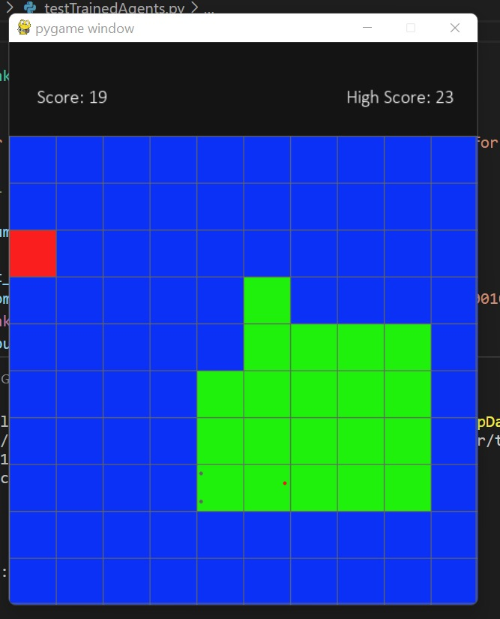
A2C Algorithm Results

Slide 8
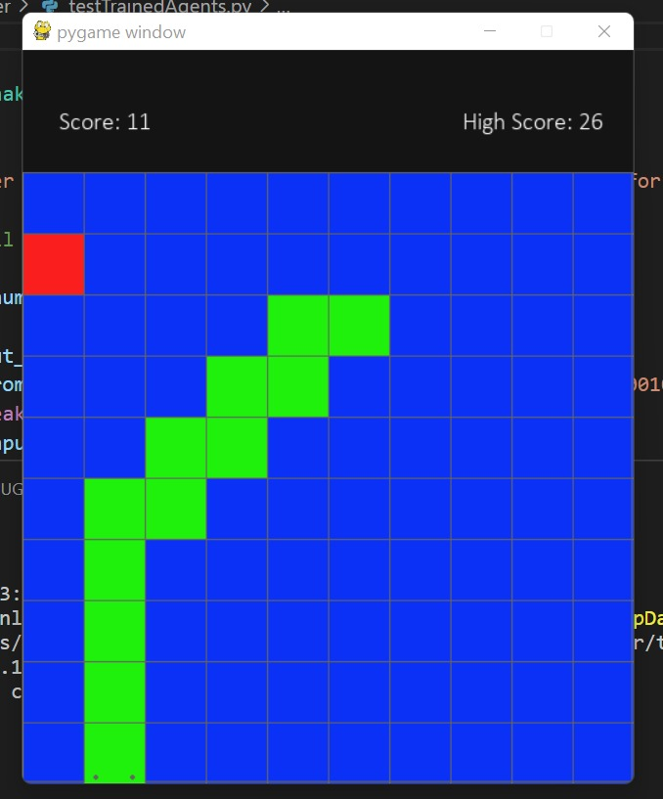
DQN Algorithm Results

Slide 9
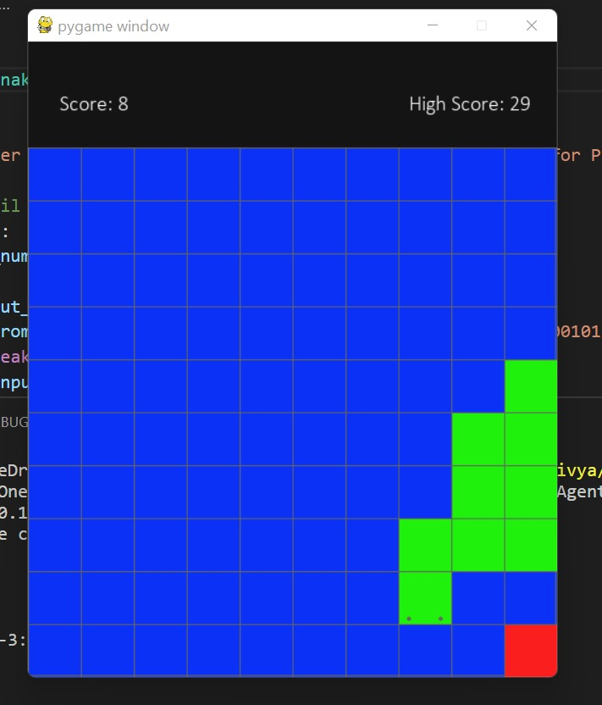
PPO Algorithm Results

Slide 10
Conclusion
Using all of the above learnings, we found that the best snake that we could train in terms of high score had the following traits:
Algorithm: PPO
Reward Structure: RS-G (the highest score is 29)
Border Represented: FALSE (No border represented = TRUE equivalent available)

